Slide 1

Lakhmi Chand Institute of Technology
Minor Project Presentation
by
Rohit Kumar, Nikita Kumar, Neha Patil
B.Tech| Computer Science and Engineering | 6th Semester

Slide 2
ViZONE
The ROBOT
Based on CV

Slide 3


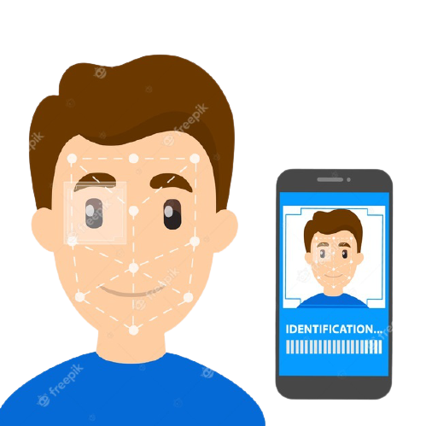


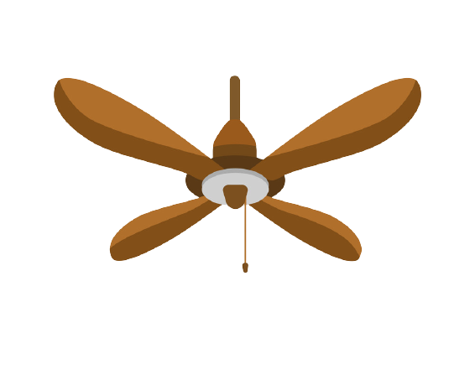
Introduction of Idea
Human Gestures

Slide 4
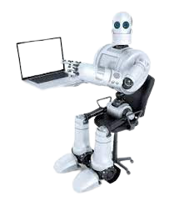

Introduction of CV
What is Computer Vision & How it Works ?
Happy
Sad
Surprised
Angry

Slide 5
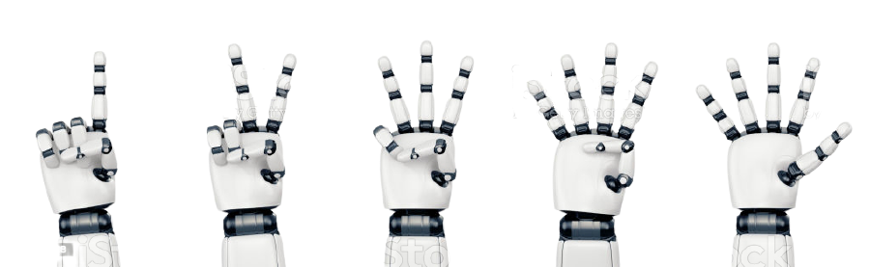
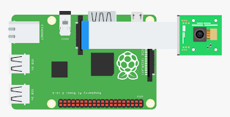

Introduction of ViZone
- The Mimic Robot
Human Hand
Robotic Action
Image Capturing

Slide 6



Software and Tools
The IDEs : -
Languages : -

Slide 7


Software and Tools
Python Packages : -

Slide 8

Problems and Solutions
Problems : -
Required more Time to Learn Packages.
Finding Compatible Version of Packages.
Solution : -

Slide 9
Project Status
Coding Section:-
Modules Created and Tested
Serial Communication is Pending
Hardware and Design Section : -
3D Designing and Printing is in Progress
Implementation is Pending

Slide 10
Project Status
Hardware and Source Code Testing Video at the End of the Presentation Slides

Slide 11
Thank You

